Slide 1
Meeting the Needs of the Social-Mobile-Connected Learner
Paul Roberge
Global Vice President, Collaborate
Paul.roberge@blackboard.com
925.788.2257

Slide 2
Michael Wesch Video
http://youtu.be/dGCJ46vyR9o

Slide 3
About Your Moderator
Over a decade leading transformative technology companies in education and e-Learning (Blackboard, Elluminate and Centra)
Passion to drive easier access to education and improve student engagement
Views are shaped by the administrators, educators, students and vendors I interact with
Father of two daughters, one in college now and one starting in the fall…

Slide 4
Student perspective rings close to home…
“25% of the students in my classes are distracted on FB, Twitter, and Instagram.”
“I learn quicker and retain more with Prof’s use of PPTs, Videos and Clicker interactions.”
“I access Bb constantly over my phone and computer, everyone loves the new upgrade and mobile – it helps organize everything into one place, which is huge. And now all Faculty use it.”
My cell # is personal for texting, so online chat with classmates I don’t know, but I know are ‘reliable’ would be huge.”
Texting with my study group is typical, and sharing pics of course.”

Slide 5
Social-Mobile-Connected
84
72
54
% communicate with peers outside setting of traditional classroom
% collaborate with peers more frequently
% facilitates a more comprehensive understanding of topics
Today’s Connected Learner

Slide 6
We Believe The Student Will Continue To Act Like “Active Consumers” In Their Education Lives, Fueled By Their Adoption of Consumer Technology

Slide 7
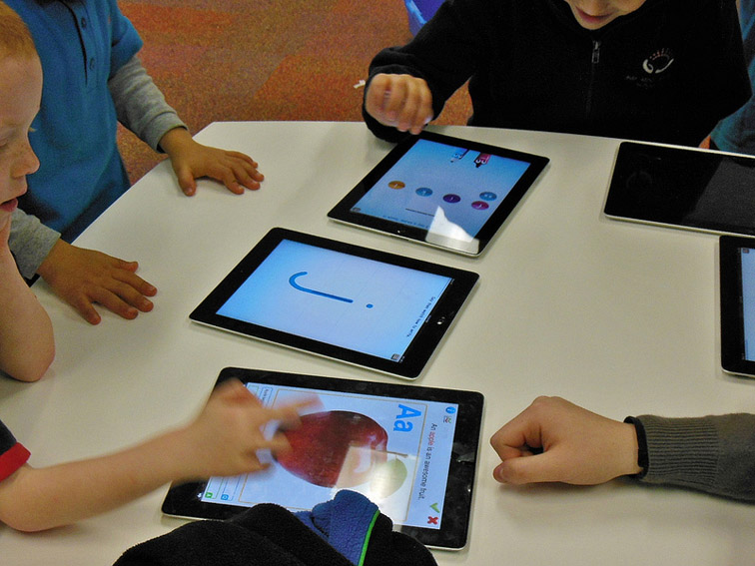
We Believe That Digital Content & Tools Will Penetrate The Classroom, And Digital Communications Channels Will Transform Engagement At An Accelerated Pace

Slide 8
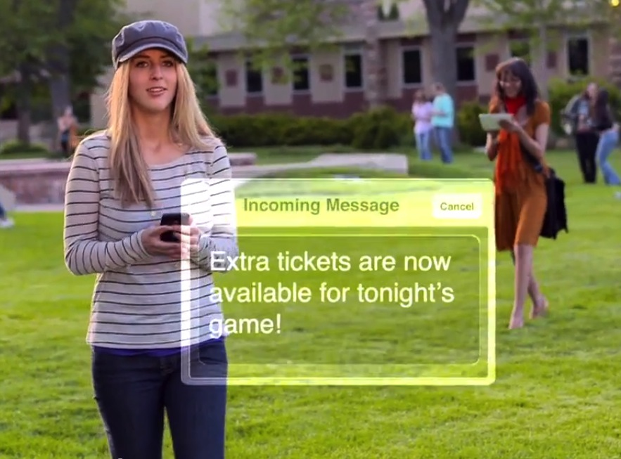
We Believe This Transformation Extends Beyond The Classroom – Beyond The Faculty-Student Relationship. It Will Reshape Every Institution Touch Point.

Slide 9
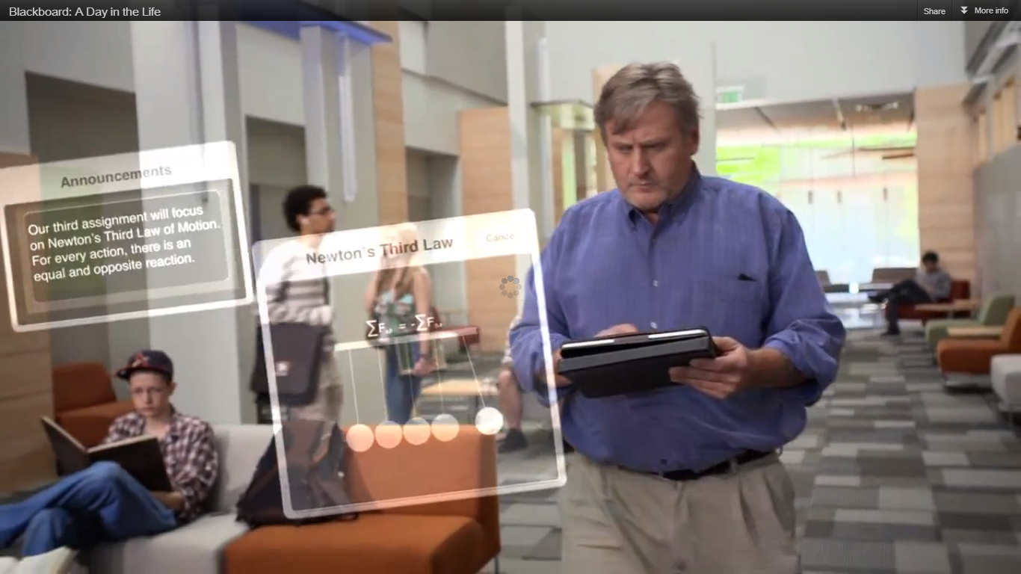
We Believe That Faculty Adoption Rate Must Accelerate To Close The Gap In Meeting Student’s Rampant Demand

Slide 10
Check point
Does this resonate?
Are our beliefs aligned with your student populations?
Are you seeing these trends accelerate, level off or decelerate?

Slide 11
Meet our Panel…
Alex McCormick
Director, National Survey of Student Engagement, Indiana University
Bryon Grigsby
VPAA, Shenandoah University
Joy Hatch
Vice Chancellor, Information Technology Services, Virginia Community College System

Slide 12
NSSE Findings on Student Use of Technology NSSE 2012 Experimental set 7,500 Seniors at 42 bachelor’s-granting institutions

Slide 13
What’s Important to Students?

Slide 14
Use of Technology to Connect with Others

Slide 15
Technology Contribution to Learning

Slide 16
MacBook and iPad University
One-Platform; Two Operating Systems
Four Year Lifecycle
Faculty Training
4000 Students
240 Faculty
Loaner Laptops
No more computer labs
Environmentally Friendly

Slide 17
Question | Year | 2009 | 2010 | 2011 | 2012
Used an electronic medium to discuss or complete an assignment | First Year C. Class | 2.66 2.60 | 2.89 2.61 | 2.85 2.66 | 2.93 2.66
 | Senior C. Class | 2.82 2.86 | 2.89 2.87 | 2.90 2.89 | 3.03 2.93

Slide 18
Question | Year | 2009 | 2010 | 2011 | 2012
Using computers in academic work | First Year C. Class | 3.30 3.30 | 3.47 3.32 | 3.48 3.32 | 3.58 3.28
 | Senior C. Class | 3.49 3.46 | 3.44 3.44 | 3.54 3.44 | 3.58 3.42

Slide 19
Question | Year | 2009 | 2010 | 2011 | 2012
Using computing and information technology | First Year C. Class | 2.91 3.03 | 3.12 3.07 | 3.21 3.05 | 3.30 3.03
 | Senior C. Class | 3.22 3.23 | 3.22 3.22 | 3.16 3.21 | 3.28 3.19

Slide 21
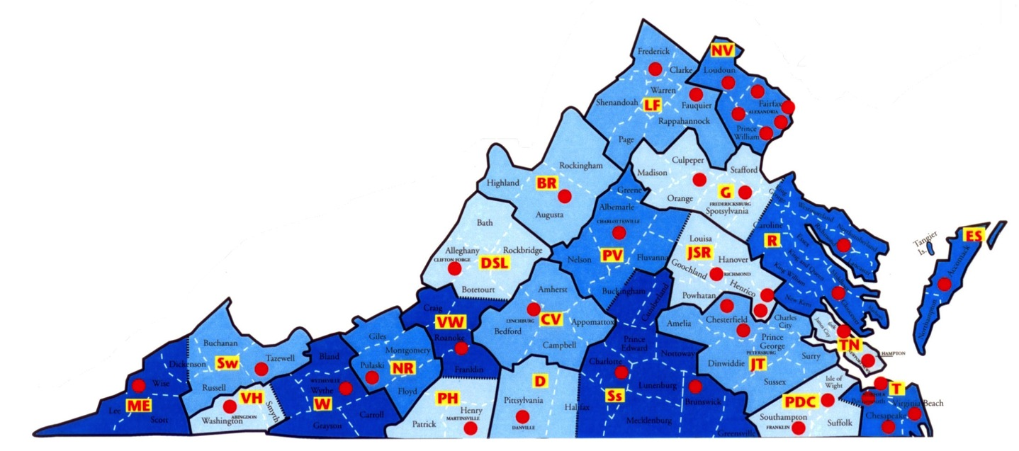
VCCS Background
23 colleges, 40 campuses
400,000+ Students
Single production instance of ERP and LMS
Private state-wide network

Slide 22
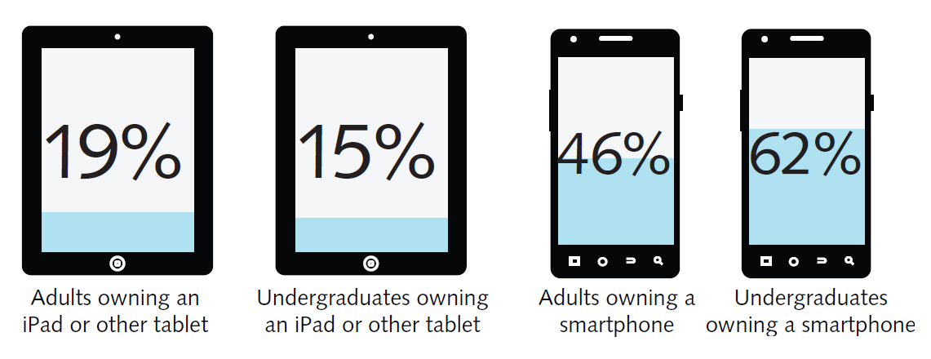
Device Ownership
EDUCAUSE ECAR Report – The Consumerization of Technology and the Bring-Your-Own-Everything (BYOE) Era of Higher Education, March 2013

Slide 23
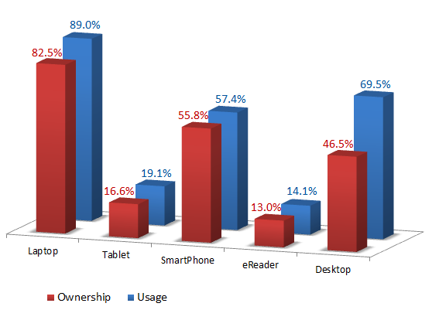
VCCS Student Ownership
ECAR National Study of Undergraduate Students and Technology, 2012

Slide 24
Mobile Project
Colleges in various stages of creating or deploying mobile apps
Performed CBA/ROI Research
Do Nothing/Status Quo – $2.5M/year
College Mobile Webpages - $1M/year
Centralize App Development - $1.5M/year
Commercial Enterprise App - $0.5M/year
Synergies from centralized deployment and the ability to share
Go Live expected in a few weeks

Slide 25
So How Do We Proceed?
Notes:
Questions

