Slide 1
Expanding High Quality Online Programs with Low Cost
Dr. Ronald Godwin, Provost – Liberty University
Shawn Boom, Vice President – Bb Services
April 5, 2013

Slide 2
Stage Setting

Slide 3
Online Enrollments growing
10X
faster than
Traditional

Slide 4
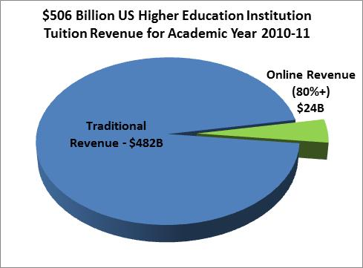
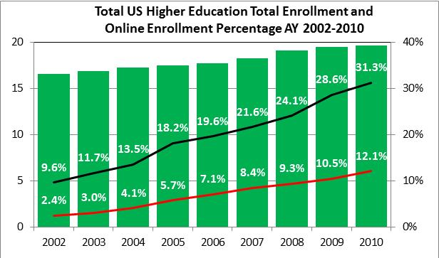
Large and Growing Market Opportunity
A
E
Summary Enrollment Statistics:
One or More Online Course | 80%+ Online Courses
6.1MM students 2010: 31% of total enrollment | 2.5MM students 2010: 12% of total enrollment 2020: 20% of total enrollment >30% of adult/graduate enrollment
Sources: 2010-2011 academic year public and private institution revenue U.S. NCES Digest of Education Statistics 2011
Online Education estimate from Eduventures Higher Education Update, 2011
Babson Survey Research Group, November, 2011

Slide 5
Large and Growing Market Opportunity
A
A
E
A
2011: $24B market.
Summary Enrollment Statistics:
One or More Online Course | 80%+ Online Courses
6.1MM students 2010: 31% of total enrollment | 2.5MM students 2010: 12% of total enrollment 2020: 20% of total enrollment >30% of adult/graduate enrollment
Sources: 2010-2011 academic year public and private institution revenue U.S. NCES Digest of Education Statistics 2011
Online Education estimate from Eduventures Higher Education Update, 2011
Babson Survey Research Group, November, 2011

Slide 6
Large and Growing Market Opportunity
A
B
A
E
A
2011: $24B market.
Total Enrollments
Summary Enrollment Statistics:
One or More Online Course | 80%+ Online Courses
6.1MM students 2010: 31% of total enrollment | 2.5MM students 2010: 12% of total enrollment 2020: 20% of total enrollment >30% of adult/graduate enrollment
B
Sources: 2010-2011 academic year public and private institution revenue U.S. NCES Digest of Education Statistics 2011
Online Education estimate from Eduventures Higher Education Update, 2011
Babson Survey Research Group, November, 2011

Slide 7
Large and Growing Market Opportunity
A
B
C
A
E
A
2011: $24B market.
Total Enrollments
# Students in >1 Online Course
Summary Enrollment Statistics:
One or More Online Course | 80%+ Online Courses
6.1MM students 2010: 31% of total enrollment | 2.5MM students 2010: 12% of total enrollment 2020: 20% of total enrollment >30% of adult/graduate enrollment
B
C
Sources: 2010-2011 academic year public and private institution revenue U.S. NCES Digest of Education Statistics 2011
Online Education estimate from Eduventures Higher Education Update, 2011
Babson Survey Research Group, November, 2011

Slide 8
Large and Growing Market Opportunity
A
B
C
A
D
E
A
2011: $24B market.
Total Enrollments
# Students in >1 Online Course
# Students in >80% Online Courses
B
C
D

Slide 9
By 2020 6.5 Million Students
will be enrolled in Fully-Online Programs generating $150B in student tuition revenue

Slide 10
69%
of higher education institutions believe online learning is a critical part of their growth strategy

Slide 11
42%
Presidents Agree/Strongly Agree that MOOCS have strong potential to have positive impact on Education

Slide 12
1 of 5
Presidents anticipate increased competition from new
Higher Education Models

Slide 13
40%
Presidents anticipate increased competition for new students

Slide 14
70%
Presidents will explore collaboration on academic programs with other institutions

Slide 15
½
Presidents will explore collaboration on administrative or student services with other institutions

Slide 16
Drivers of Online Growth
Student Demands
Workforce Development
Funding Challenges
Competitive Response

Slide 17
Adapting for Online Growth
Student Outcomes & Experience
Government Involvement
Business-Driven Model
Strong Governance
Faculty Success
Marketing Savvy
Technology Innovation

Slide 18
What About Governance?
&
What Should I Build vs. Buy?

Slide 19
Questions about How to Execute
Colleges
Or Dept
Coordinated or
Shared
Central Unit
Outsource fully
or temporarily
Central Unit
Program Selection
Marketing/Recruiting
Course Design/Training
Course Delivery
Student Services
Academic Support
Assessment
Enrollment Reporting
Recruiting
Marketing
SAMPLE

Slide 20
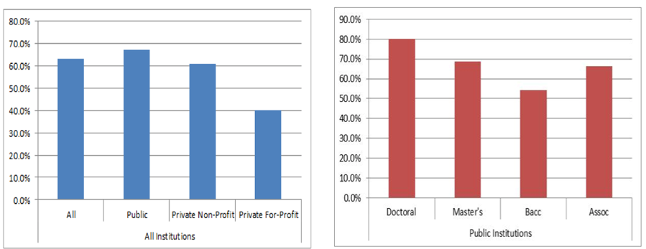
62% of University Presidents Considering Outsourcing Administrative Services

Slide 21
Key Capabilities for Online Growth
Vision & Strategy
Program Design
Solution Design & Development
Market Research
Enrollment & Financial Aid Support
Opportunity & Capabilities Analysis
Faculty Training & Development
Learning Management Systems & Partners
Brand & Marketing Strategy
Registration & Orientation Support
Business & Financial Modeling
Instructional Design
Social Learning & Collaboration
Creative Development
24X7 Help Desk
Operations Design & Reporting
Course Development & Delivery
Systems Integration
Promotion & Lead Generation
Retention & Student Success
Management & Governance
Faculty Support
Security & Compliance
Admissions Support & CRM
Career Placement

Slide 22
Key Capabilities for Online Growth
Vision & Strategy
Program Design
Solution Design & Development
Market Research
Enrollment & Financial Aid Support
Opportunity & Capabilities Analysis
Faculty Training & Development
Learning Management Systems & Partners
Brand & Marketing Strategy
Registration & Orientation Support
Business & Financial Modeling
Instructional Design
Social Learning & Collaboration
Creative Development
24X7 Help Desk
Operations Design & Reporting
Course Development & Delivery
Systems Integration
Promotion & Lead Generation
Retention & Student Success
Management & Governance
Faculty Support
Security & Compliance
Admissions Support & CRM
Career Placement

Slide 23
7th Inning Stretch
2 Stickers Per Person
Allocate them to the areas of most interest for discussion

Slide 24
Liberty University’s Story of Growing Quality Online Programs at Scale

Slide 25
Discussion and Q &A

Slide 26
Who feels they have achieved growth of your online programs at scale while keeping costs measured and quality high?

Slide 27
Liberty learned a lot through trial and error of many years. What have you learned by seeking to grow your online or hybrid programs through your own trial and error?

Slide 28
Do you have a highly polished and honed marketing engine?
Do you know your cost per student acquisition?
Have you refreshed your value proposition lately? How did it change?

Slide 29
What do you think about using creative financing and shared risk models for funding your online strategy?

Slide 30
What questions are top of mind in your organization with regards to institutional growth and viability?

Slide 31
What is your faculty model and how does that help/challenge your growth objectives?

Slide 32
Do you have a rubric by which you assess readiness to launch an online program?

Slide 33
How does that help/challenge your growth objectives?

Slide 34
Do you run into state authorization challenges? If so, how are you overcoming them?

