Slide 1
Welcome to the alliance for virtual learning’s webinar #2
Brought to you by

Slide 2
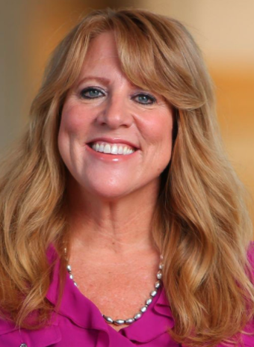
Introduction
Pam Roggeman
Pam Roggeman currently serves as the Academic Dean for the College of Education at University of Phoenix. Previously she worked as Clinical Assistant Professor and led secondary education programs for the graduate and the undergraduate teacher prep programs at Arizona State University. She also served more than 17 years as a secondary education English teacher and was named an Arizona Educational Foundation Teacher of the Year Ambassador of Excellence.

Slide 3
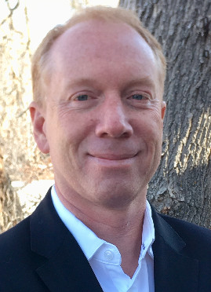
Moderator
John Watson
John is the founder and CEO of the Evergreen Education Group, which runs the Digital Learning Annual Conference and the Digital Learning Collaborative. For nearly 20 years, Evergreen Education Group has been researchers and advisors to school districts, state agencies, foundations, companies, and NGOs seeking to improve educational opportunities and outcomes.

Slide 4
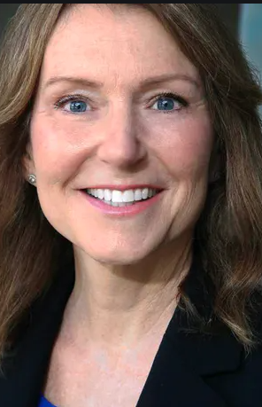
panelist
Lisa Dawley
Lisa is Executive Director of the Jacobs Institute for Innovation in Education at the University of San Diego and co-inventor of Pactful, an app to support social good innovation with teens. Formerly, she served as a professor of Educational Innovation, Technology and Entrepreneurship at UNC Chapel Hill School of Education, where founded ImagineLab, a UNC initiative to support teen innovation. Lisa was co-author of the Going Virtual! research series studying professional development for K-12 online teachers.

Slide 5
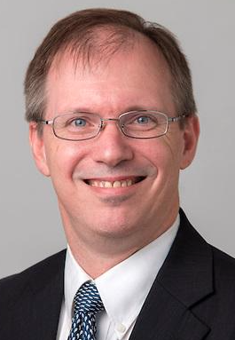
panelist
Dan Gohl
Dan is the Chief Academic Officer for Broward County Public Schools in Fort Lauderdale Florida, as well as a seasoned K-12 educator with experience as a teacher, principal, school designer, researcher, professional developer, district and state level change agent. He has successfully designed and implemented technology-based solutions in the domains of curriculum, instruction and assessment. Dan is focused on ensuring that all students are educated for college readiness and able to live a life of self-discerning engagement in their communities.

Slide 6
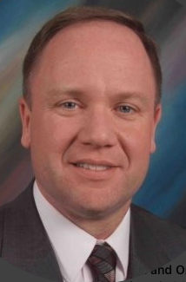
panelist
Lonnie Luce
Lonnie is the Executive Director at Blended and Online School Solutions (BOSS) and a veteran educator with a long history of helping students, traditional and virtual schools, and communities achieve and exceed their growth targets. Lonnie has served as a superintendent to high performing schools and was recognized as Superintendent of the Year for the state of Louisiana in 2014. A retired Colonel in the Louisiana Army National Guard, he was awarded a Bronze Star for his service in Afghanistan.

Slide 7
panelist
DeWayne McClary
DeWayne is the Director of the League of Innovative Schools for Digital Promise and works to increase engagement and impact for their network of innovative schools and districts. Prior to this role, he was Director of Educational Technology and Library Programs at D.C. Public Schools, where he supervised DCPS’s 1:1 pilot and roll-out and other innovation initiatives. DeWayne has broad and deep experience as a teacher and district leader. He has worked in rural South Carolina, the suburbs of Virginia, and at an urban D.C. school district.

Slide 8
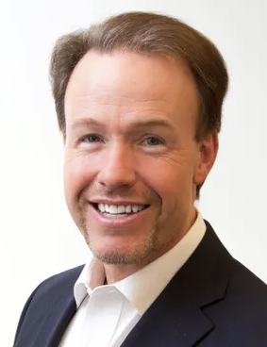
panelist
Heath Morrison
Heath is former President of McGraw Hill’s School Group. He has extensive experience in the K-12 education space, including a rich history serving as school principal and superintendent. Leveraging his connections with superintendents around the country, Heath brings a unique and deeply informed perspective to the gaps superintendents are seeing in their pivots to online learning and how best to meet their evolving needs.

Slide 9
3 big ideas for online learning – DeWayne McClary
Digital Equity
Devices and internet, digitization of curriculum, digital citizenship, digital literacy
Master Scheduling
How are districts going to address how students’ schedules will look, what is being taught, remediation (students should not lose instructional time for this)
Social-Emotional Learning (SEL)
Every student has dealt with some form of trauma (COVID-19, Racial Disparities, prior trauma)

Slide 10
3 big ideas for online learning – Lisa dawley
Online Teaching is Developmental
Professional development needs change based on years of experience
Develop a PD plan for years 1-3
Base on NSQ Online Teaching Standards
Encourage self-assessment and reflection
Distinguish Between Online Teaching and Online Curriculum Design
Teachers focus mainly on facilitation and possible supplemental design
Overall curriculum strategy should be coordinated by the district
Supporting Student Engagement and Social-Emotional Learning
Engagement is created through choice and authentic learning that allows students to create and build
Peer-based pedagogy and a blend of synchronous/asynchronous can support engagement and SEL needs
Must have an LMS (content storage), email and webinar technology, at a minimum

Slide 11
3 big ideas for online learning – dan gohl
Provide a clear vision of how learning will occur
Provide simple, direct statement of intention, design and experience expectations
Have resources to address specific concerns (e.g. Special Education, ELL, Gifted, early learners)
Have systems to gather and respond to questions and complaints
Ensure Infrastructure exists to deliver the vision
Devices – Connectivity – Destination
Communications systems – integrated synchronous and asynchronous
Implement, monitor and intervene with fidelity to vision
Train staff be comfortable with tools; frustration is contagious
Remind staff to draw on expertise of educating students; tactics change, strategic direction does not
Always conduct processes with priority on nourishing relationships

Slide 12
3 big ideas for online learning – lonnie luce
Infrastructure
Choosing content that is intuitive, engaging, and meets the state standards is key to success.
Providing a device and Internet access to those who don’t have them is critical. Some may have a student population that can BYOD, but many of us must provide devices and some Internet access for this to work well.
Student Information Systems, Learning Management Systems, and some form of Business Intelligence that all work together well and provide data to make real time instructional decisions are critical.
Professional Development
Training teachers and administrators how to use the systems and how to motivate students and parents is necessary for success.
Engagement
Engagement is the key to success. How do you inspire, monitor, motivate, hold accountable, and love your students from afar?

Slide 13
3 big ideas for online learning – heath morrison
Focus on Hybrid Approaches with Virtual Learning Based on Multiple Reopening Scenarios
How to leverage effective teaching and learning in the classroom and remotely with staggered schedules, reduced class sizes, alternate calendars and other options schools are considering
How to plan for students’ academic, social and emotional needs in reconnecting and reassessing children and using virtual learning to address gaps
Commit to Authentic Professional Development and Purposeful Technology for Both Classroom and Virtual Learning Digital Transformation
How to access success of current virtual learning plans for students, teachers and parents
How to evaluate digital tools and solutions and professional development and gaps between what teachers have and what they truly need
Ensure Effective Parallel Plans in Both Safely Returning Students and Staff to School
How to ensure equity with access to devices, broadband, programs and professional development
How to reimagine key school systems and functions with digital transformation

Slide 14
Discussion with panelists

Slide 15
Join us for the summer virtual teaching academy June 26 – July 1, 2020
https://go.blackboard.com/virtual-teaching-academy

