Slide 1
Analytics Vision to Realization-
Strategies, Lessons, and Insights
Reflections from a
Chief Academic Officer
Start
here!
Dr. Marti Venn
Vice President for Academic Affairs
Middle Georgia State College
Analytics Vision to Realization-
Strategies, Lessons, and Insights

Slide 2
Higher Education
Higher Education
Analytics Vision to Realization-
Strategies, Lessons, and Insights
Notes:
Marti

Slide 3
Our Story
Higher Education
Analytics Vision to Realization-
Strategies, Lessons, and Insights
Notes:
Marti

Slide 4
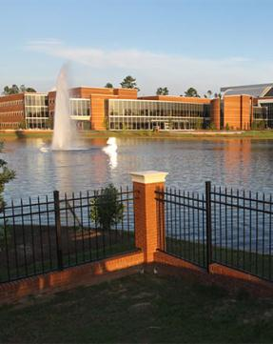
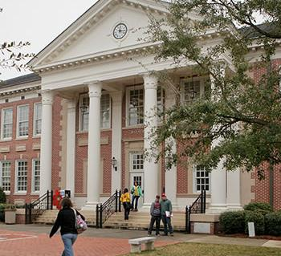
institutional context
Founded in 1968 in Central Georgia as a two year institution (2 campuses)
Commuter Campus to Residential Campus (beginning Fall 2010)
Consolidation- Middle Georgia State College
5 campuses
Analytics Vision to Realization-
Strategies, Lessons, and Insights
Notes:
Marti

Slide 5
motivation for change
Belief:
It is the right thing to do!
External Pressures
Performance-based budgeting
Presidential accountability
University System of Georgia Board of Regents
Complete College Georgia/America
Analytics Vision to Realization-
Strategies, Lessons, and Insights
Notes:
Marti

Slide 6
historical use of data
Vision hits reality!
Sporadic in terms of understanding:
student population
program development
resource allocation
Campus Data Silos
Total Frustration!
What did I need to address reality?
Analytics Vision to Realization-
Strategies, Lessons, and Insights
Notes:
Marti

Slide 7
a new way of doing...
Smart Planning
Decision making informed by data
Historical
Targeted Implementation
Goals
Aligned Resources
Accountability
Results-oriented
Reporting-structures (technology)
Future-Oriented
Benchmarks
Aligned Strategies
Mission Driven
Analytics Vision to Realization-
Strategies, Lessons, and InsightsAnalytics Vision to Realization-
Strategies, Lessons, and Insights
Analytics Vision to Realization-
Strategies, Lessons, and Insights
Notes:
Marti

Slide 8
vision
Perception becomes Reality
Changing perception meant looking in the mirror
Deconstructing faculty myths around Retention, Progression and Graduation rates
Alignment of efforts across the entire institution
Building a Culture of Accountability
Analytics Vision to Realization-
Strategies, Lessons, and Insights
Notes:
Marti

Slide 9
stages of faculty grief
Denial
Anger
Bargaining
Depression
Acceptance
Analytics Vision to Realization-
Strategies, Lessons, and Insights
Notes:
Marti

Slide 10
transfer population
Potential Problem:
What effect is our transfer population having on progression, retention, and graduation?
Analytics Vision to Realization-
Strategies, Lessons, and Insights

Slide 11
example01.transfer population
MGSC Total New Transfers Compared to New Student Population
 | Total of New Student Population | # of New Transfers | % of Total New Student Population
Fall 2008 | 3079 | 658 | 21%
Fall 2009 | 3225 | 779 | 24%
Fall 2010 | 2854 | 674 | 24%
Fall 2011 | 2381 | 599 | 25%
Fall 2012 | 2674 | 758 | 28%
Analytics Vision to Realization-
Strategies, Lessons, and Insights
Notes:
John

Slide 12
example01.transfer population
Analytics Vision to Realization-
Strategies, Lessons, and Insights

Slide 13
example01.transfer population
Analytics Vision to Realization-
Strategies, Lessons, and Insights

Slide 14
example01.transfer population
Spring 2013 Transfer Population Registration Trends
Registration | # | %
Prior to 1st Day of Classes | 485 | 90.7%
On 1st Day of Classes | 25 | 4.7%
2nd Day of Classes | 7 | 1.3%
3rd Day of Classes | 14 | 2.6%
4th Day of Classes | 4 | 0.7%
TOTAL | 535 | 100%
Analytics Vision to Realization-
Strategies, Lessons, and Insights

Slide 15
example01.transfer population
Pertinent Questions:
How to fast track transfer students, particularly those with > 60 credit hours, to put them into a graduation trajectory?
Should all transfer applicants be admitted?
How do we get transfer students registered before classes begin?
Analytics Vision to Realization-
Strategies, Lessons, and Insights
Notes:
Marti

Slide 16
transfer population
Policy Changes:
Met with VP of Enrollment Management and her team
Eliminate practice of transfer students being admitted just prior to the start of the semester
Eliminate practice of admitting students prior to analyzing transcripts
Create an Academic Review Committee to evaluate any transfer student with a G.P.A lower than our G.P.A. for new students prior to provisionally admitting them
Analytics Vision to Realization-
Strategies, Lessons, and Insights
Notes:
Marti

Slide 17
transfer population
Alignment and Effectiveness of Resources:
Campus Budget Hearings (1/2013)
University System of Georgia Budget Hearings (2/2013)
Implementing new systems to address transfer students
Utilizing data metrics to assess whether our resource deployment is effective in terms of transfer student success
Analytics Vision to Realization-
Strategies, Lessons, and Insights
Notes:
Marti

Slide 18
realizations..
Quick wins and long-term goals
Align fiscal resources to campus wide and project specific initiatives
Change campus policies and practices AND engage in curriculum redesign
AND SIMULTANEOUSLY
Analytics Vision to Realization-
Strategies, Lessons, and Insights
Notes:
Marti

Slide 19
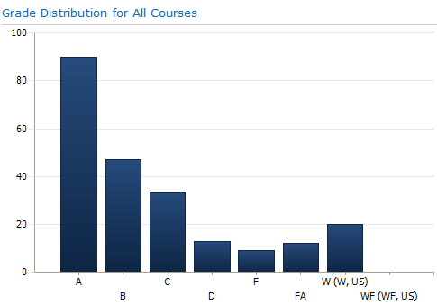
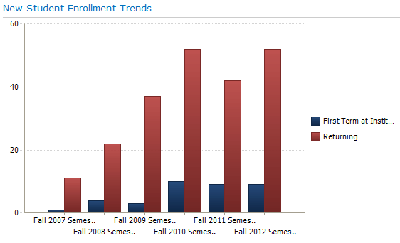
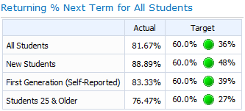
data in the right hands
Dashboards
Available to all Deans and Department Chairs
Provides on-the-spot snapshots of
Enrollment Metrics
Degrees Conferred Metrics
Returning Student Metrics
Success Metrics
Align academic administrators, faculty and academic staff annual evaluations, promotion, tenure and post-tenure systems
Analytics Vision to Realization-
Strategies, Lessons, and Insights

Slide 20
Start
here!
QUESTIONS?
Analytics Vision to Realization-
Strategies, Lessons, and Insights

